Slide 1
Knowledge Representation in AI

Slide 2
Introduction
Human beings are good at understanding, reasoning and interpreting knowledge.
• And using this knowledge, they are able to perform various actions in the real world. But how do machines perform the same?

Slide 3
What is Knowledge Representation?
Knowledge Representation in AI describes the representation of knowledge.
• Basically, it is a study of how the beliefs, intentions, and judgments of an intelligent agent can be expressed suitably for reasoning.
• One of the primary purposes of Knowledge Representation includes modeling intelligent behavior for an agent.

Slide 4
What is Knowledge Representation?
Knowledge Representation and Reasoning (KR, KRR) represents information from the real world for a computer to understand and then utilize this knowledge to solve complex real-life problems like communicating with human beings in natural language.
• Knowledge representation in AI is not just about storing data in a database, it allows a machine to learn from that knowledge and behave intelligently like a human being.

Slide 5
What to Represent?
The different kinds of knowledge that need to be represented in AI include:
– Objects: All the facts about objects in our world domain. E.g., Guitars contains strings, trumpets are brass instruments.
– Events: Events are the actions which occur in our world.
– Performance: It describe behavior which involves knowledge about how to do things.

Slide 6
What to Represent?
– Facts: Facts are the truths about the real world and what we represent.
– Meta-Knowledge: It is knowledge about what we know.
– Knowledge-base: The Knowledgebase is a group of the Sentences (Here, sentences are used as a technical term and not identical with the English language).

Slide 7
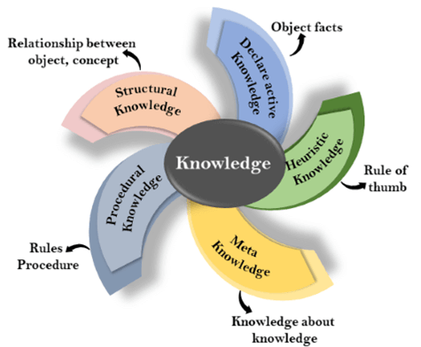
Types of Knowledge

Slide 8
Declarative Knowledge
Declarative knowledge is to know about something.
– It includes concepts, facts, and objects and expressed in a declarative sentence
It is simpler than procedural language.

Slide 9
Procedural Knowledge
Procedural knowledge is a type of knowledge which is responsible for knowing how to do something.
It is also known as imperative knowledge.
It can be directly applied to any task.
It includes rules, strategies, procedures, agendas, etc.
Procedural knowledge depends on the task on which it can be applied.

Slide 10
Meta-knowledge
Knowledge about the other types of knowledge is called Meta-knowledge.

Slide 11
Heuristic knowledge
Heuristic knowledge is representing knowledge of some experts in a filed or subject.
Heuristic knowledge is rules of thumb based on previous experiences, awareness of approaches, and which are good to work but not guaranteed.

Slide 12
Structural knowledge
Structural knowledge is basic knowledge to problem-solving.
It describes relationships between various concepts such as kind of, part of, and grouping of something.
It describes the relationship that exists between concepts or objects.

Slide 13
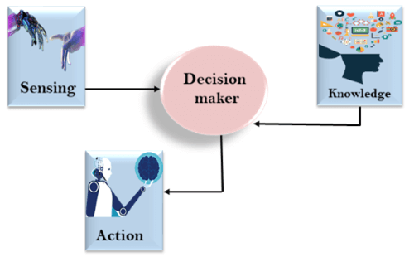
The relation between knowledge and intelligence
Knowledge plays an important role in demonstrating intelligent behavior in AI agents.
An agent is only able to accurately act on some input when he has some knowledge or experience about that input.

Slide 14
The relation between knowledge and intelligence
In this diagram, there is one decision-maker whose actions are justified by sensing the environment and using knowledge.
• But, if we remove the knowledge part here, it will not be able to display any intelligent behavior.
• Now that you know the relationship between knowledge and intelligence, let’s move on to the techniques of Knowledge Representation in AI.

Slide 15

Queries

